Slide 1
Bellabeat Smart Device Usage Analysis
Ezana Gebremichael
June 2026

Slide 2
Business Task
Analyze non-Bellabeat fitness tracker data to identify usage trends, then translate those insights into actionable marketing recommendations for a Bellabeat product.

Slide 3
Questions:
What are some trends in smart device usage?
How could these trends apply to Bellabeat customers and help influence Bellabeat’s marketing strategy?

Slide 4
Questions:
What are some trends in smart device usage?
How could these trends apply to Bellabeat customers and help influence Bellabeat’s marketing strategy?

Slide 5
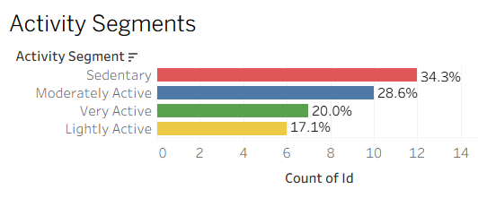
Most Users Are Sedentary (34.3%)
Larger than very active users combined with lightly active users
Notes:
Average daily steps: 7,358 — 26% below the recommended 10,000 step goal

Slide 6
Half Of Users Don't Wear Their Device Every Day
Only 49% of users wore their device consistently every day.
Some users missed up to 75% of days.
2 users had zero step days more than 40% of the time.
Notes:
Device abandonment and inconsistent wear is a significant challenge across fitness tracker users — suggesting barriers

Slide 7
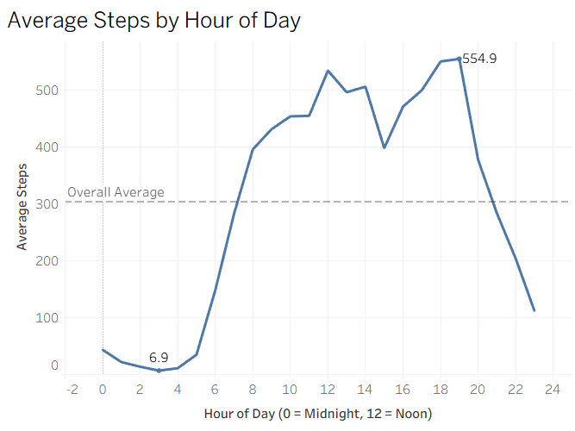
Users Are Most Active In The Evening
Peak activity at 7PM with average 554 steps per hour
Notes:
After-work exercise is the primary form of physical activity — suggesting users fit movement around their work schedule rather than before it

Slide 8
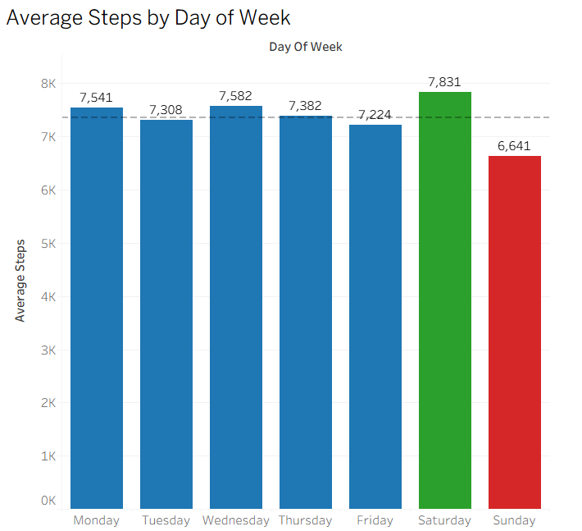
Saturday Is Most Active, Sunday Is Most Sedentary
Saturday averages 7,831 steps
Sunday averages 6,641 steps
Difference of nearly 1,200 steps between best and worst day
Notes:
Users naturally exercise more when free from work obligations, but Sunday represents a significant activity drop suggesting end of weekend fatigue or deliberate rest

Slide 9
Sitting More Is Linked To Sleeping Less
Sedentary minutes vs sleep correlation: -0.59
It's not about how much you exercise, it's about how much you sit. Reducing sedentary time shows a stronger link to better sleep than increasing step count alone
Notes:
No simple correlation was found between overall activity levels and sleep duration — the sedentary time relationship is the more precise and actionable finding

Slide 10
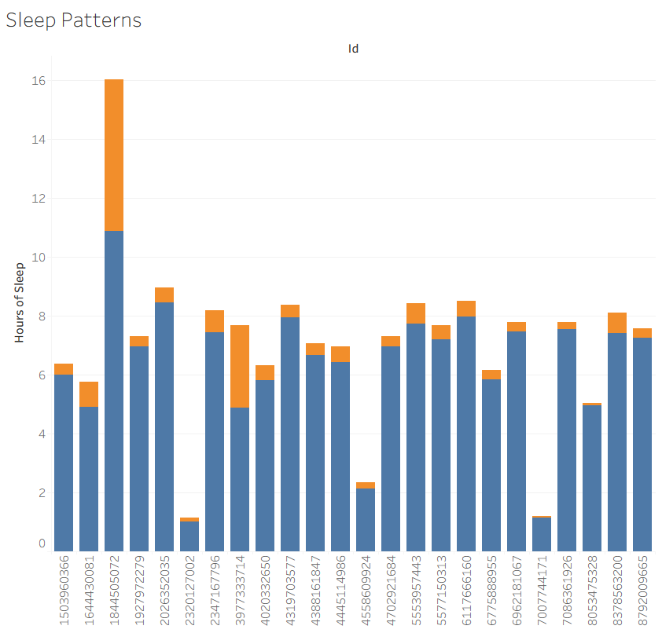
Users Struggle With Sleep Quality
Average sleep: 6.99 hours, barely meeting 7 hour minimum
Users are not only sleeping too little but spending significant time lying awake
Notes:
Time awake in bed may include non-sleep activities like watching TV — Fitbit cannot distinguish between the two

Slide 11
Questions:
What are some trends in smart device usage?
How could these trends apply to Bellabeat customers and help influence Bellabeat’s marketing strategy?

Slide 12
Improve Device Design Appeal To Drive Consistent Wear
Finding:
Only 49% of users wear their device consistently suggesting comfort, style, or motivation barriers
Recommendation:
Bellabeat should invest in discreet, aesthetically pleasing device designs that blend naturally into everyday outfits.
Highlight the Leaf's versatile wearability in marketing.
Show real people wearing devices in everyday non-workout settings.
Implement gentle app reminders encouraging consistent daily wear.
A tracker only works when it's worn, and design should make wearing it effortless.
Notes:
inconsistent wear means incomplete data and reduced product value

Slide 13
Help Users Sit Less To Sleep Better
Finding:
Move more during the day, sleep better at night
Recommendation:
Bellabeat should create targeted in-app messaging specifically connecting prolonged sitting to poor sleep quality.
"You've been still for 2 hours — a short break could improve tonight's sleep"
Create a sedentary streak alert feature in the app.
Market the Bellabeat Membership program with sleep improvement content specifically targeting sedentary users.

Slide 14
Deliver The Right Message At The Right Time
Finding:
Users have predictable activity patterns that generic notifications don't account for
Recommendation:
Bellabeat should implement smart time-based notifications that align with users' natural activity patterns.
Send workout reminders at 5-6PM on weekdays.
Send weekly goal summaries and achievements on Sunday evenings to motivate Monday starts.
Notes:
Meet users where they naturally are — don't fight their patterns, work with them

Slide 15
Data Sources & Limitations
These findings should be treated as directional insights. Further research with a larger, more recent, and demographically defined dataset is recommended before making major strategic decisions.
Data Source:
FitBit Fitness Tracker Data
Source: Kaggle (Mobius), CC0 Public Domain License.
Collected via Amazon Mechanical Turk.
Period: March 12, 2016 — May 12, 2016.
35 unique users across 6 datasets.
Limitations:
The sample size of 35 users is too small to be statistically representative of all fitness tracker users. The data is from 2016 (nearly 10 years old) meaning habits may have changed significantly since collection. No demographic information is available, so we cannot confirm these users represent Bellabeat's target audience. Additionally, the data shows WHAT users do but cannot explain WHY they behave that way.

Slide 16
Thank You.

Slide 17
Ezana Girmay Gebremichael
Email: ezanagebremichael@gmail.com
LinkedIn: https://www.linkedin.com/in/ezanagebremichael/
Tableau Public: https://public.tableau.com/app/profile/ezanagebremichael

